Slide 1
Parents Welcome Meeting 13th September 2017

Slide 2
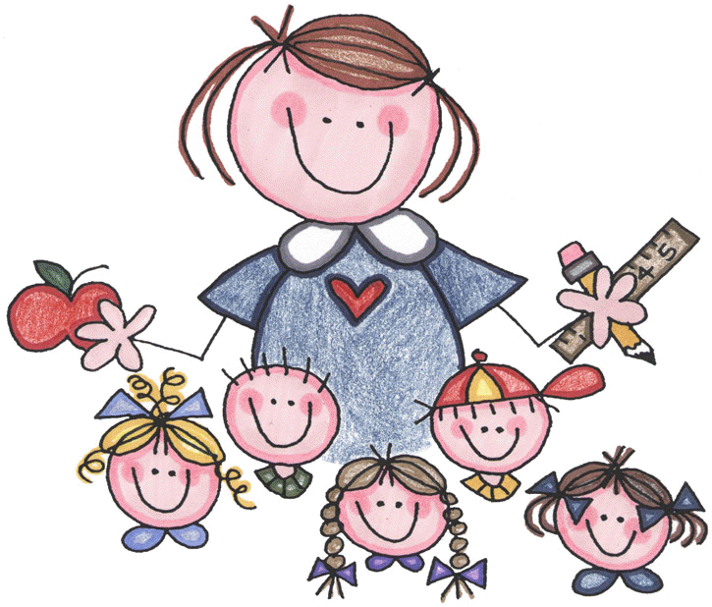
Staff
Cróna – Acting Principal
Anita – Chestnut Class – Junior Infants
Diarmaid – Ash Class – Junior Infants
Gary - Support Teacher
SNA: Simona

Slide 3
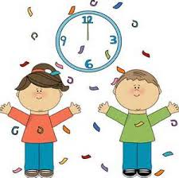
School times
School Day:
School Opens at 8.20 am
Junior : 8.30am-1.10pm
Senior: 8.30am – 2.10pm
* It is important that the children are in school to participate in morning activities
Break Time: 10.10-10.20 am
Lunch Time: 12.00-12.30pm

Slide 4
School Day - Mornings
Basketball courts are opened @ 8.20am
Pupils are encouraged to congregate in the basketball courts each morning from 8.20am.
NEVER leave a child unsupervised in the school yard. They are not insured to be there and the school is not responsible for children until Cróna and staff go to yard at 8.20am.
Pupils are received by the class teacher at 8.30am.

Slide 5
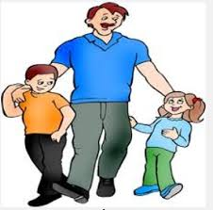
Collections
Only those people listed on your child’s collection form are permitted to collect your child.
If a person who the class teacher has not previously met is collecting your child, please let the teacher know in advance.
Any adult unknown to staff collecting children (without teacher’s knowledge) will be brought to the office. Parents/Guardians will be contacted to seek approval for releasing children. Adults will also have to sign collection book & give contact details to the school.

Slide 6
Attendance
National Education Welfare Board (NEWB) is responsible for ensuring all children are attending school.
We are legally obliged to inform NEWB of absences that amount to 20 days and/or when we are concerned about attendance.
For unexpected absences: Please phone the school 01 8272018 or email info@powerstownet.com before 9.30am.
On return to school, please ensure you give the teacher a completed Absence Explanation Form. This form can be obtained from the class teacher and/or the office.
Ann, the school secretary will contact parents/guardians in relation to unexplained absences @10am every morning.

Slide 7
Punctuality
Children are asked to be in school on time for an 8.30am start.
If a child arrives to school after 8.40 am, parents have to sign the child into the school in the “Late Book” in the office.
Child is then escorted to class by an adult in the office as formal classes have commenced.
Time of arrival is logged on our computer system.
If a child is continuously late, parents will receive a letter and be requested to attend a meeting in the school.

Slide 8
Primary School Curriculum (1999)
11 discrete subject areas
Language:
English & Irish (Gaeilge)
Mathematics
Social Environmental and Scientific Education:
History, Geography & Science
Arts Education:
Visual Arts, Music, Drama
Physical Education
Social Personal & Health Education
Ethics Curriculum:
‘Learn Together Curriculum’ (Moral & Spiritual/Beliefs System/Ethics & the Environment/ Equality & Justice)

Slide 9
Learn Together Programme
Learn Together is our Ethics Curriculum.
There are four strands
Moral and Spiritual
Ethics and Environment
Equality and Justice
Belief Systems
We will focus on a bi-annual calendar to ensure we have a broad and balanced curriculum.
Keep an eye on our notice board to see what we are doing in class.

Slide 10
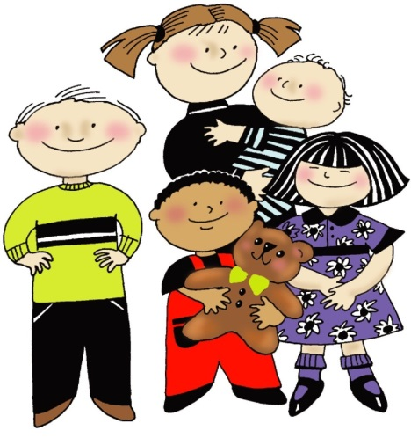
Uniform
No school uniform
Comfortable, practical clothes
Minimal jewellery
Suitable footwear (velcro if possible)
Tie hair back
Label all belongings
No trolley bags!
School bag big enough to hold HW folder
Class P.E. day – Tuesday & Wednesday
Practice putting on and taking off coat at home

Slide 11
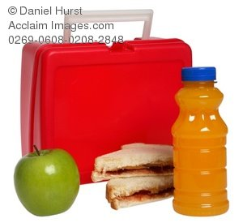
Healthy Eating
2 Lunch breaks
Sandwiches/crackers/wraps/rice cakes
Fruit & vegetables
Cheese, set yogurts, rice
Drinks: water/juices/milk
Please ensure the children can open all packaging and food independently
Meals for School Scheme will not be processing applications for new schools, therefore it is parents’/guardians’ responsibility to provide child with his/her lunch.

Slide 12
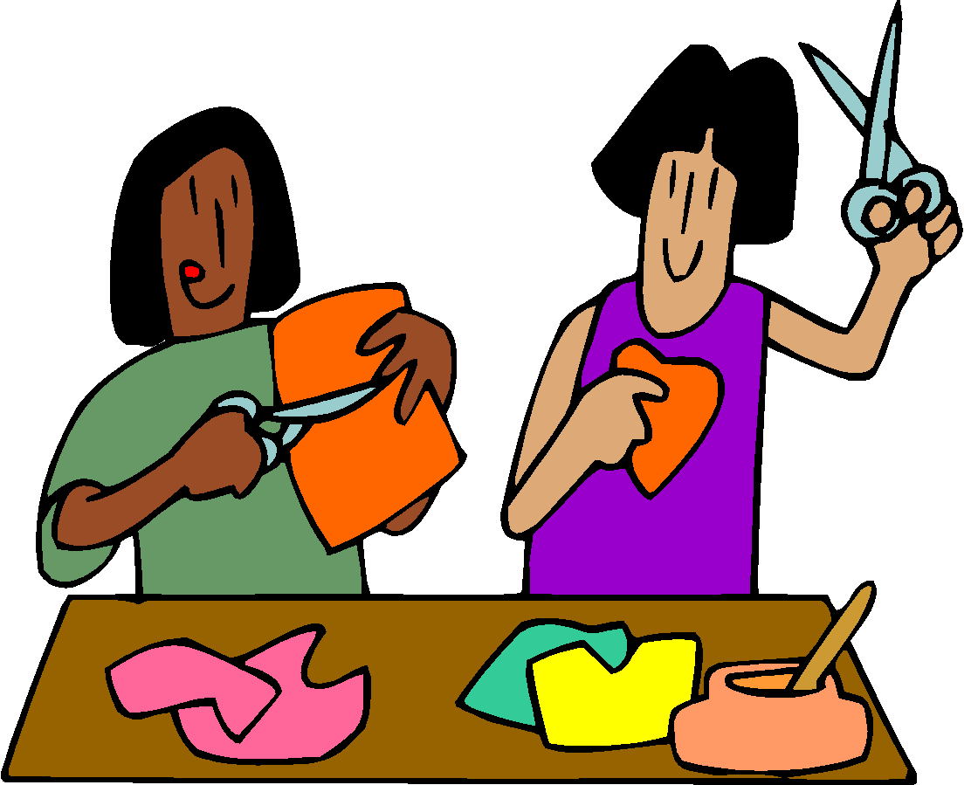
Language Development
It is very important for children to develop their home languages as well as English
Support your children speaking, reading and writing in their home languages at home

Slide 13
Gaeilge/Irish
The Irish language is one of the three core subjects and the language is valued and used throughout our school.
Irish is taught by all teachers in all classes for 30 minutes every day.
We also use Irish informally throughout the day e.g. “Dún on doras!”
We greet each other on the corridors, in the yard and in the classrooms in Irish.

Slide 14
Aistear
Aistear is the early childhood curriculum framework for all children from birth to six years. It has 4 themes:
Well-being
Identity and Belonging
Communicating
Exploring and Thinking
It is based on the theory that children learn through play.
Children will learn about a range of themes through hands-on stations – construction, drama, english, water/sand, art, etc

Slide 15
Homework
Homework will begin for Junior Infants from Monday 02nd October
Each child will receive a homework folder, homework will go home each Monday and should be returned on Thursday for correction on Friday
Approximately 10 minutes should be spent on homework

Slide 16
Classroom Management
Positive behaviour managment– Traffic Light Systems:
Everyone starts in the green light
Verbal warning; Move to the orange light
Verbal warning; Move to the red light
Inform parent at the end of the day if child goes to red
We will work on a target – ie work on putting their hand up, sitting on chair, being kind to others, etc

Slide 17
Classroom Management
Rewards and Treats
Move to blue or yellow on traffic light system
Praise and encouragement
Stickers, stamps, Golden Time
ClassDojo points
Jobs and Responsibilities
Classroom helpers
School Council & Green Schools Committee

Slide 18
Parental Involvement
Powerstown E.T.N.S believes in cultivating a strong working relationship with parents and welcomes assistance in any way from the parent body.
Informal
Parents own skills (art, IT, cooking, gardening)
Enhancing learning (learning resource)
Reading Programmes (Shared/Paired reading)
Homework
Coffee mornings every Friday morning at 8.30am in parents room
Formal
Parents Association, Board of Management, Fundraising initiatives, Help on special events

Slide 19
Parent Teacher Association
The PTA is a group of parents and teachers that work together for the best possible education of the students in the school
We work together with the principal, teacher representative, staff and the board of management to create a positive and effective partnership between home and school.

Slide 20
Sign up for PTA
Please sign up for the PTA.
We need your help, enthusiasm and ideas!
Contact sheets for PTA are here.

Slide 21
Keep in touch ☺
Find out about all our adventures in learning, school events and announcements through:
Powerstown E.T.N.S. Website
Powerstown E.T.N.S. Facebook
Ash & Chestnut Class Blog as well as class dojo Stories
Contact us on Email:
Anita@powerstownet.com
Diarmaid@powerstownet.com
Phone: 01 8272018

